Slide 1


Sales Revenue Dashboard with KPI Tracker
Comprehensive Analysis of Revenue Streams, Regional Trends, and Team Productivity metrics for the current fiscal period.
Presented by –
Mukesh Mishra
Saubhagya Munsi

Slide 2
Table of contents
Slide Name | Slide Number
Front page | 1
Table of contents | 2
Features of the project | 3
Project Structure | 4
Tech stacks and tools | 5
Different types of techniques to be followed | 6
Dashboard | 7
Various formulas used here | 8
Work segment | 9
Acceptability of this project | 10
Project at a glance | 11
Project summary | 12

Slide 3
Features of the project
Interactive KPI dashboard for instant business performance monitoring.
Dynamic slicer-based filtering for customized business analysis.
Comprehensive sales performance analysis across time and geography.
Automated top performer identification for decision-making support.
Target achievement tracking for performance evaluation.
Order lifecycle monitoring for operational visibility.
Supports strategic decision-making through actionable business insights.

Slide 4
📁Project Structure
Raw Data
Clean Data
Data Cleaning Instructions
SalesPerson performance Analysis
Revenue vs Category Analysis
Delivery Status ( Category wise ) Analysis
Regional Analysis
KPI Calculation Sheet
Executive Dashboard
Home page
*Note:- The highlighted sheets are hidden from workbook

Slide 5
🛠️Tools & 💻Tech Stack |🌐Data Source
Tools: Microsoft Excel, Pivot Tables, Pivot Charts, Slicers, Conditional Formatting, Advanced Excel Functions, Data Validation, Excel Tables, KPI Dashboard Design.
Data Source: Kaggle
GitHub: Link

Slide 6
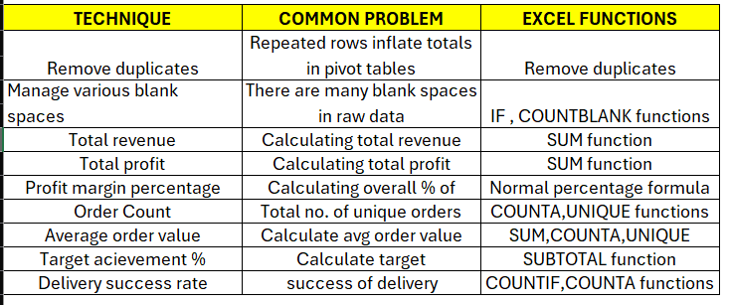
Data Cleaning techniques

Slide 7
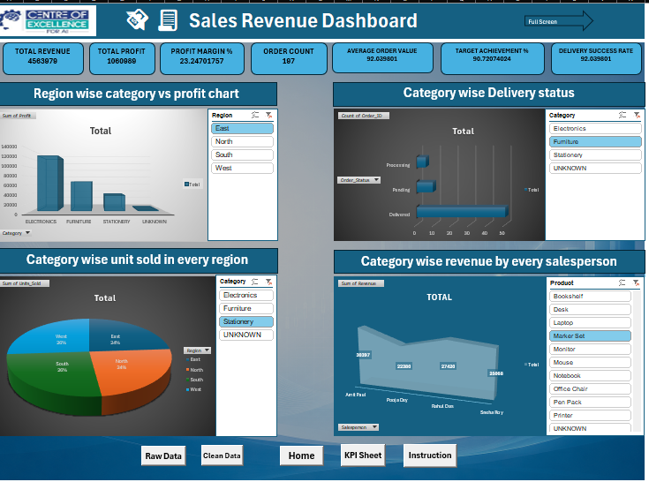
Dashboard

Slide 8
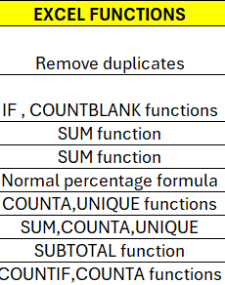
Used Formulas and functions

Slide 9
Mukesh
Cleaning Data
Saubhagya
All technical parts of excel
Prepare the full excel file according to requirements
Look upon the softskill part
Work segment

Slide 10
Why Is This Project Acceptable?
Solves a Real Business Problem
Uses Data-Driven Decision Making
Shows analytical skills
Uses Industry-Relevant Excel Features
Provides Interactive Reporting
Includes Performance Monitoring
Easy to Understand and Scalable
Demonstrates End-to-End Workflow

Slide 11
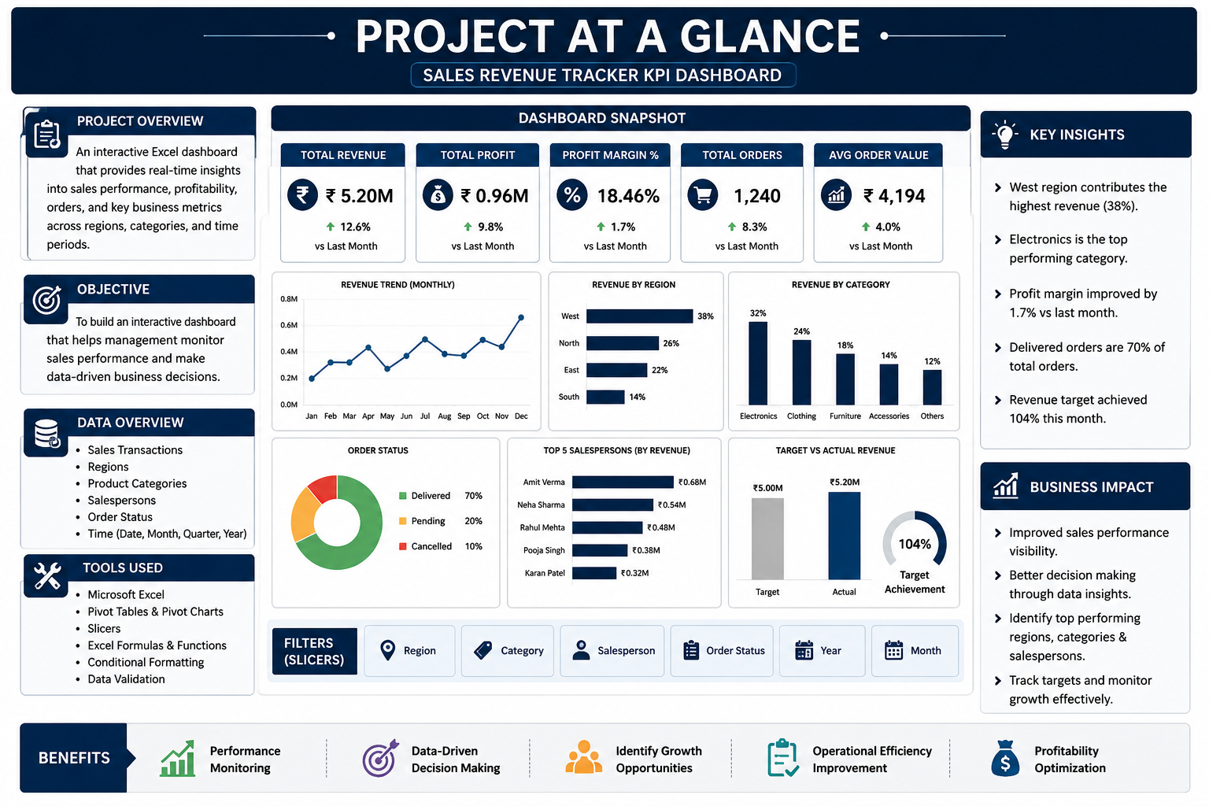
At a glance

Slide 12
Project Summary The Sales Revenue Tracker KPI Dashboard is an interactive Excel-based business analytics project designed to monitor sales performance, profitability, customer orders, and business growth. The dashboard transforms raw sales data into meaningful insights using KPIs, charts, slicers, and trend analysis, enabling management to make efficient data-driven decisions.

Slide 13
Thank You

